Slide 2
Agenda
Introduction and moderation by Layla Sawyer, Secretary General, currENT Europe
Claude Turmes, Energy Minister of Luxembourg
Susanne Nies, Board Chair of currENT
Paula Abreu Marques, Head of Unit at DG ENER
Giles Dickson, CEO of WindEurope

Slide 4
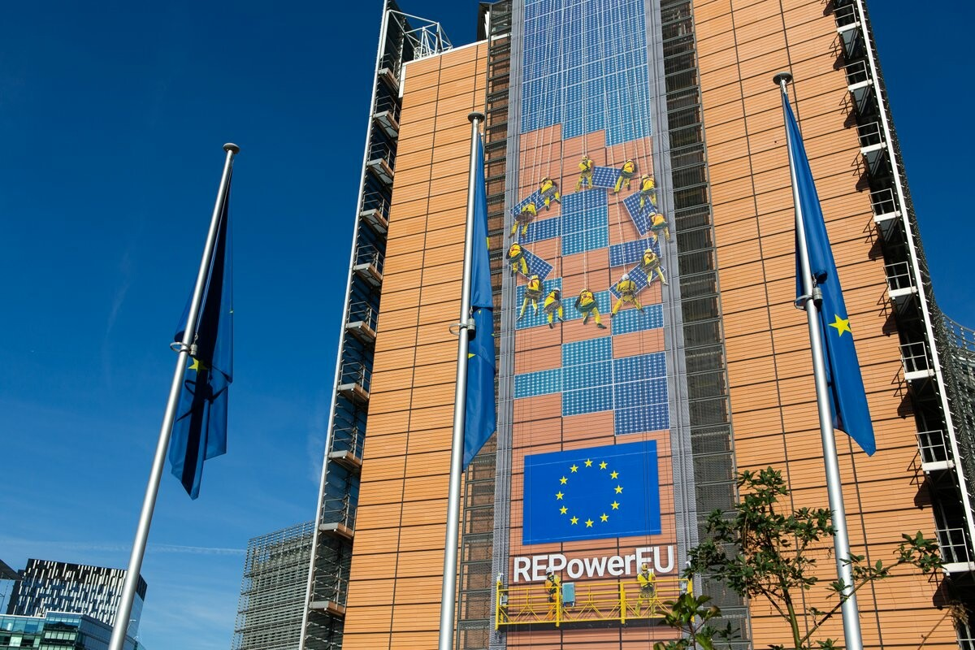
The big picture
Formidable renewables targets
Wind: from 190GW today to 510GW in 2030
Solar: 136 GW 2020 and to add 600 GW by 2030
Market reform and uncertainty for Investors, supply chain challenges
-> Are electricity grids keeping up?

Slide 5
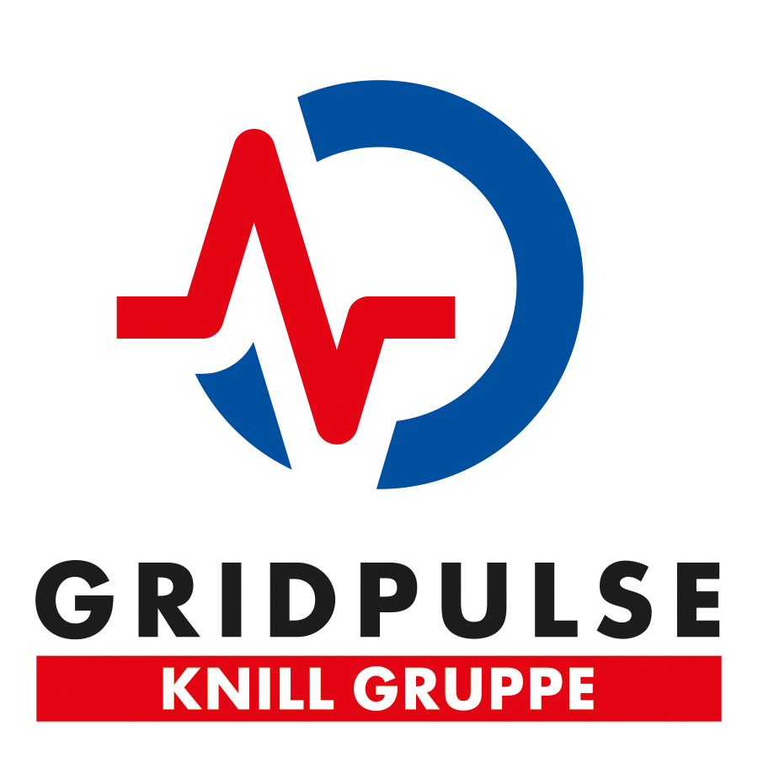
currENT Europe is the voice of Europe’s innovative grid technology companies
“Our vision is for the European power network to be recognised as the world leader in decarbonisation through the efficient use of innovative grid technologies”

Slide 6
Innovative Grid Technologies
① control the timing of production and consumption
② divert the power flow to less crowded paths
③ increase the capacity of the shortest path
Topology Control
Dynamic Line Rating
Utility Storage / demand response / hydrogen
Modular FACTS / PST
HTLS / Superconductors

Slide 9
Act fast.
Value proposition by currENT members and proposals for change in the new NECPs.
Webinar 20 October 2022
Susanne Nies, Board Chair currENT

Slide 10
Innovative Grid Technologies can help Member States achieve NECP goals
currENT has analysed how the 27 Member States consider innovative grid technologies in their NECPs
Similar exercise has already been done for the 70% Action Plans for cross-border trade, was launched at Florence Forum in June.

Slide 11
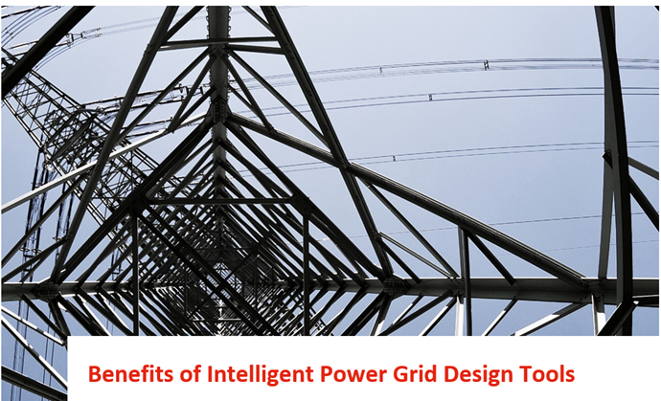
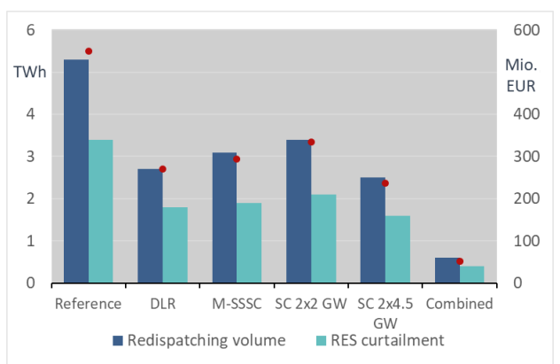
Consentec: GETs toolbox can save 90% of redispatching costs in 2030
Combination of Dynamic Line Rating, M-SSSC and Superconductors:
90% reduction in congestion and redispatch costs
3 TWh avoided RES curtailment
Dec 2021

Slide 12
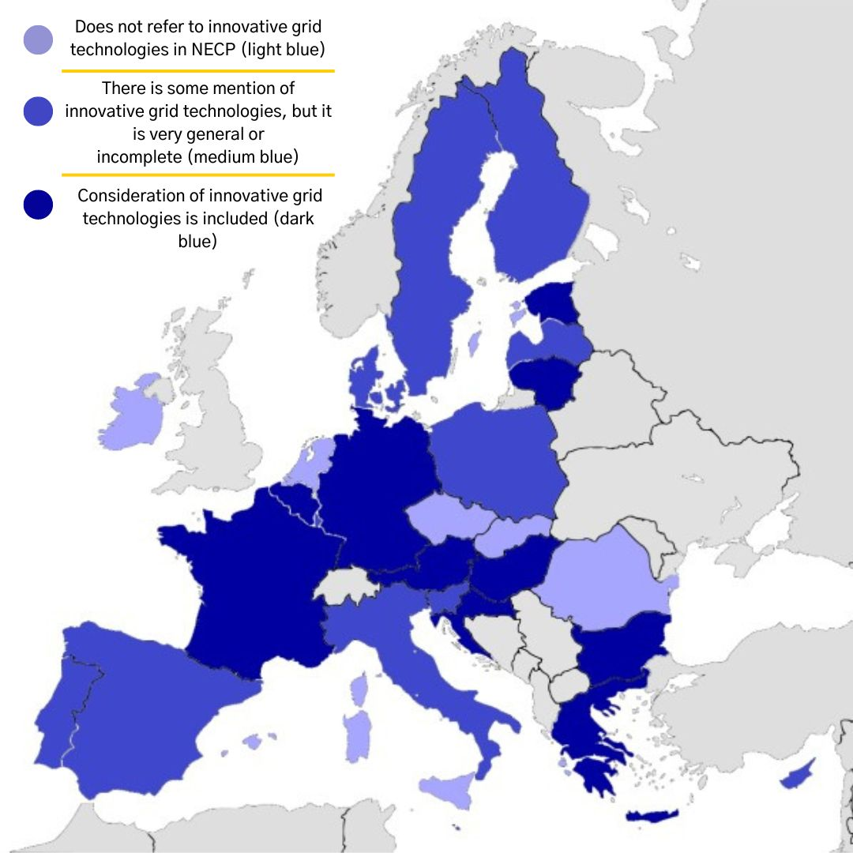
Results currENT analysis NECPs
8 countries do not consider innovative grid technogies at all
9 countries consider some relatively innovative grid technologies
10 country considers many different innovative grid technologies

Slide 13
Our seven recommendations for the next NECPs,
And for Now
NECP - THE reference for national, and in conjunction, European Net Zero trajectories
Efficient use of infrastructure through the Energy Efficiency First Principle, that includes System Efficiency.
NOVA principle to be applied everywhere when talking about the electricity grid, and transparency in its implementation is key.
Better alignment between NECPs and Network Development Plans.
NECPs to include technology toolbox, and also emerging technologies, their expected impact. From Sandboxes to Pathfinder: we need everything for the uptake
NECPs to include non-binding agreements on offshore network development plans for renewables, established by Article 14 of the recently revised Trans-European Networks for Energy (TEN-E).
European Commission/ACER to assess the benefits of innovative grid technologies for the next two winters and for reaching climate neutrality.
! Save Energy through Redispatch and curtailment avoidance, Now!

