Slide 1
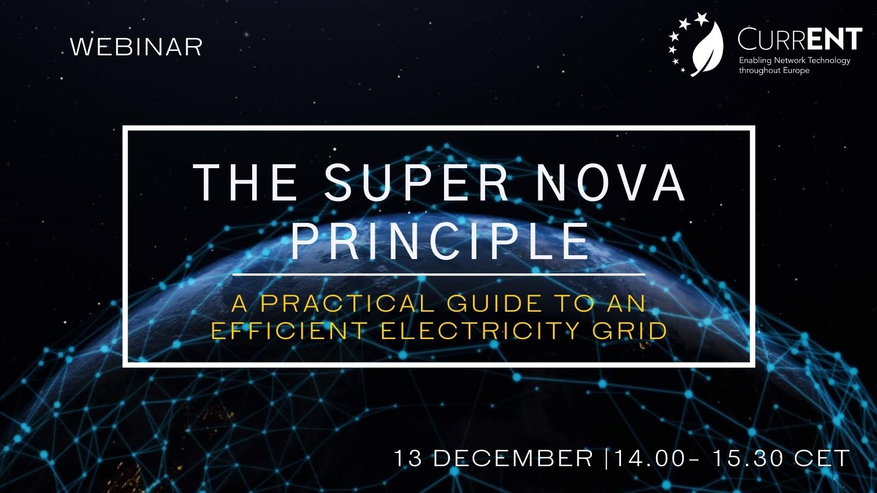

Slide 2
Agenda
Introduction and moderation by Layla Sawyer, Secretary General, currENT Europe
Frederic Vassort, CEO of Ampacimon
Peter Hughes, Vice President Europe at CTC Global
Hedd Roberts, General Manager Europe at Smart Wires
Lars Stephan, Policy and Market Development Manager at Fluence
Patricia Labra, Head of network planning at Red Electrica and convener of the TYNDP at ENTSO-E

Slide 3


Slide 4



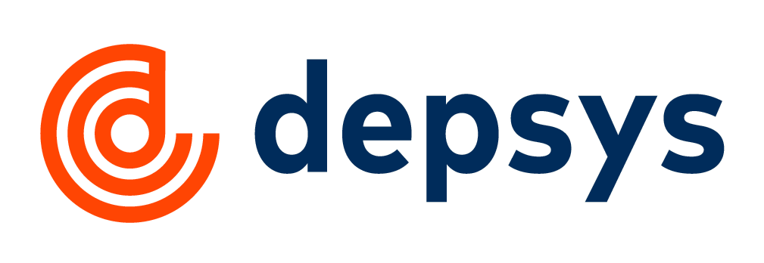

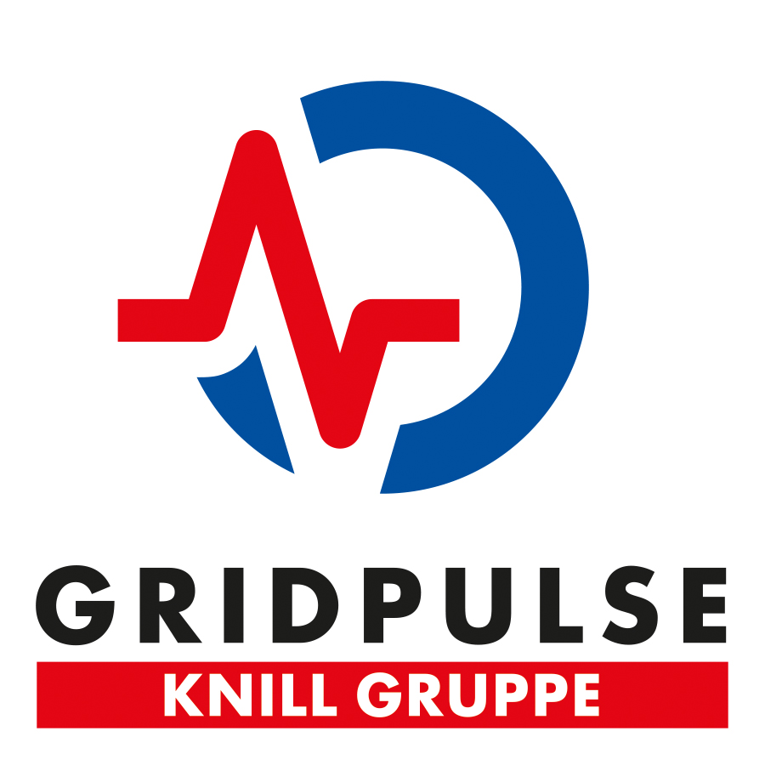






currENT Europe is the voice of Europe’s innovative grid technology companies

Slide 5
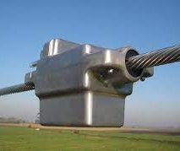
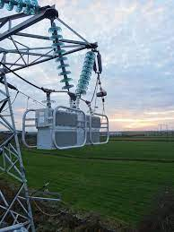
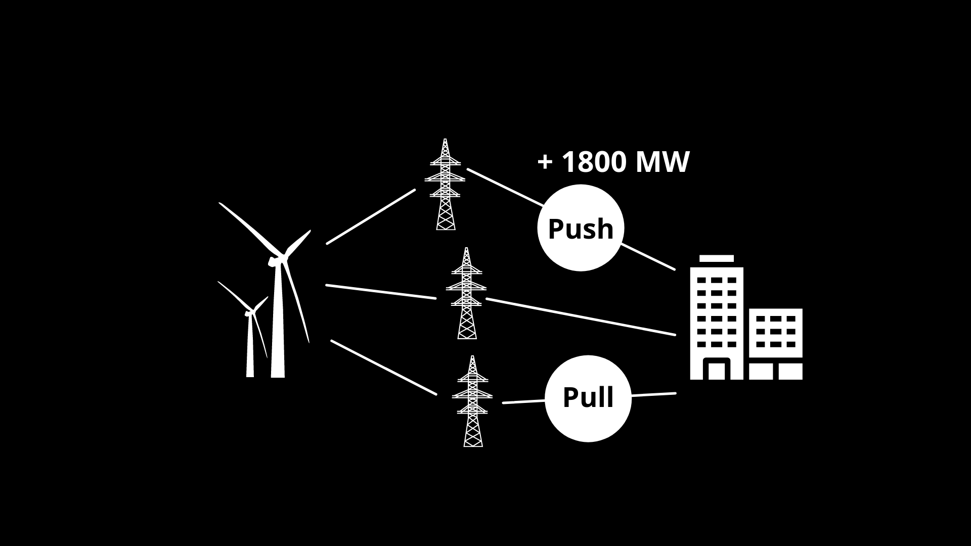
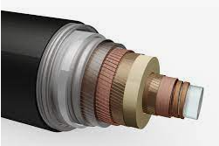

Innovative Grid Technologies
Hardware, software and associated protocols applied to existing transmission facilities that increase the network’s operational transfer capacity, and maximise the efficiency of new grids
Topology Control
Dynamic Line Rating
Utility Storage / demand response / hydrogen
Modular FACTS
HTLS / Superconductors

Slide 6
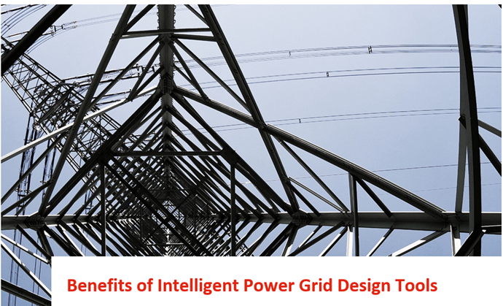
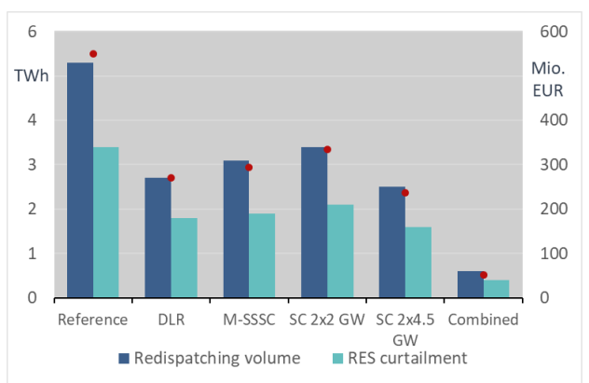

Consentec: Innovative Grid Technologies can save 90% of redispatching costs in 2030
Combination of Dynamic Line Rating, M-SSSC and Superconductors:
  90% reduction in congestion and redispatch costs
  3 TWh avoided RES curtailment
Dec 2021

Slide 7
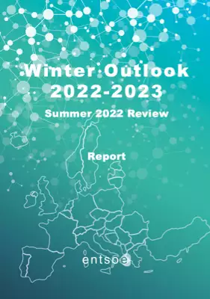
ENTSO-E Winter outlook 2022/2023 – More critical situation than previous winters
System stress identified in Ireland, France, Southern Sweden, Finland, Malta and Cyprus systems.
The electricity system remains highly dependent on gas, yet favourable weather conditions may relieve this reliance for the power system.
Close follow-up is needed on the uncertainties around nuclear availability in France, Sweden and Finland, as well as coal supply in Germany and Poland.
From: ENTSO-E 2022/2023 Winter Outlook, 1 Dec

Slide 8
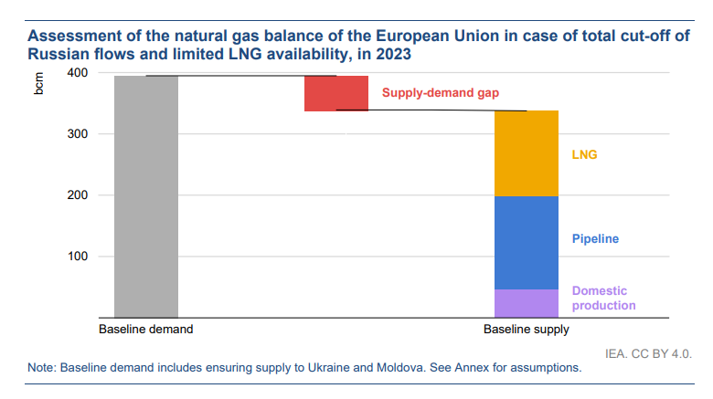
Supply-demand gap for winter 2023
From IEA latest report, 12 Dec: How to Avoid Gas Shortages in the European Union in 2023

Slide 9
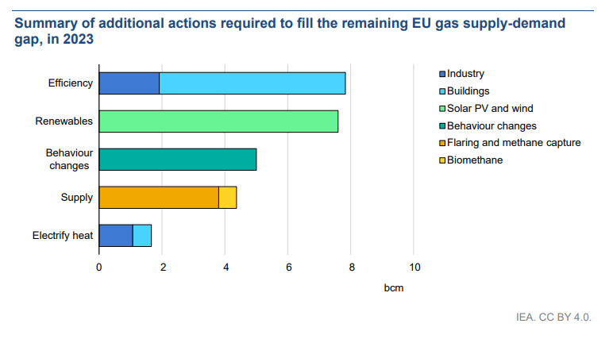
Additional actions required to fill the gap
Recommendation: Ensure sufficient grid capacity to allow renewable electricity to displace gas consumption!
From IEA latest report, 12 Dec: How to Avoid Gas Shortages in the European Union in 2023

Slide 10
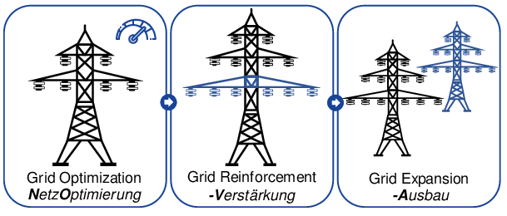
How to get more electricity through the existing lines quickly?
Important: transparency in how decisions are made

Slide 11

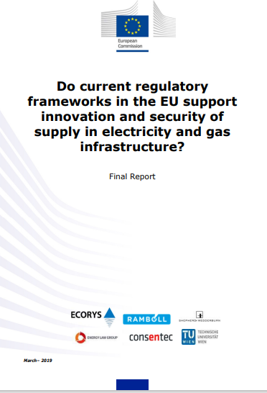


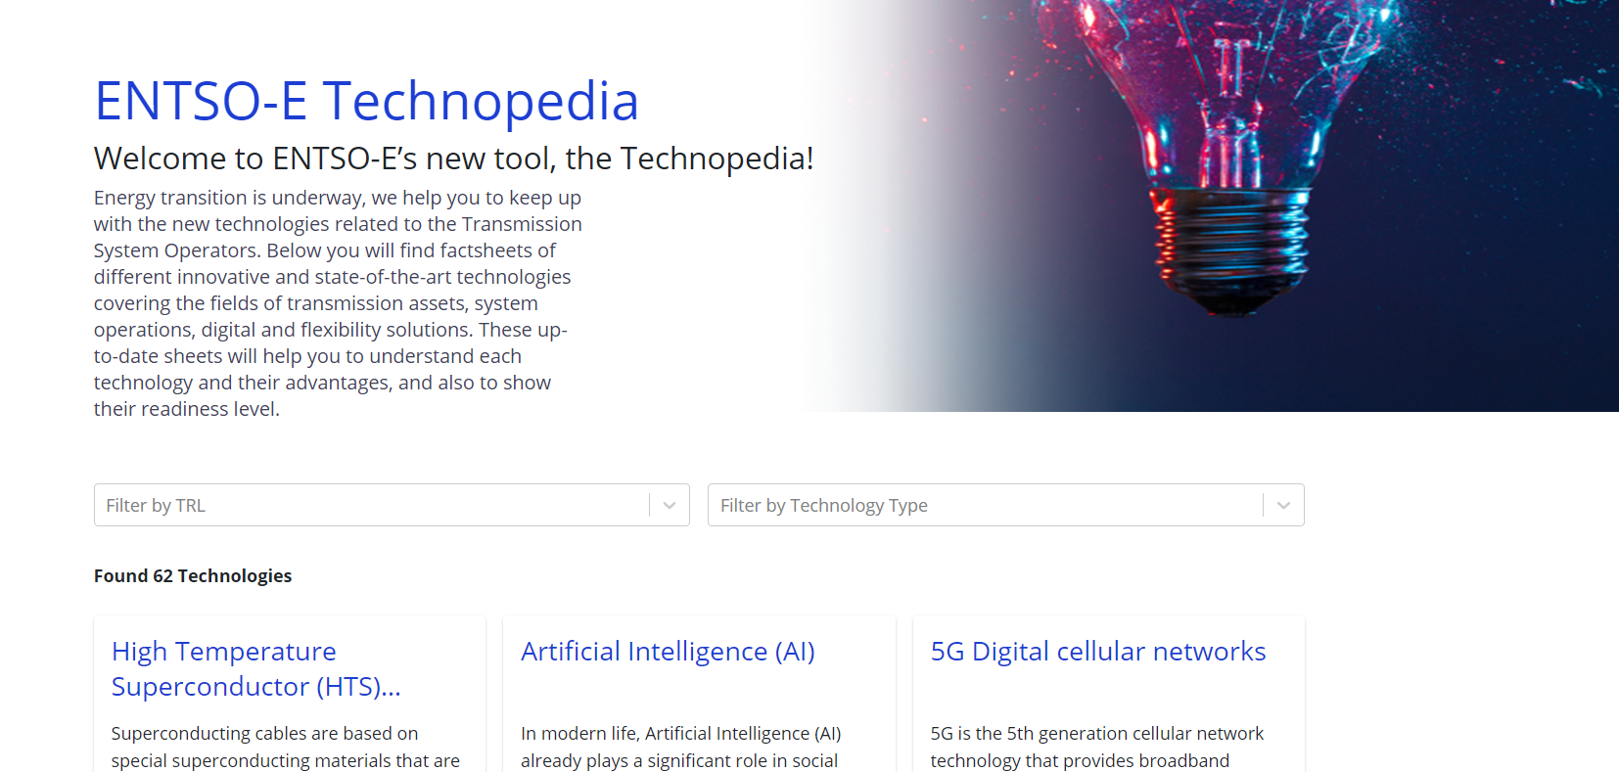
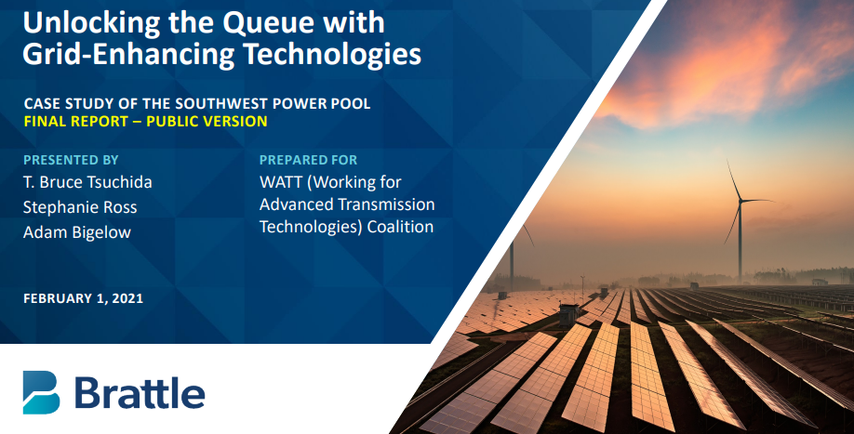
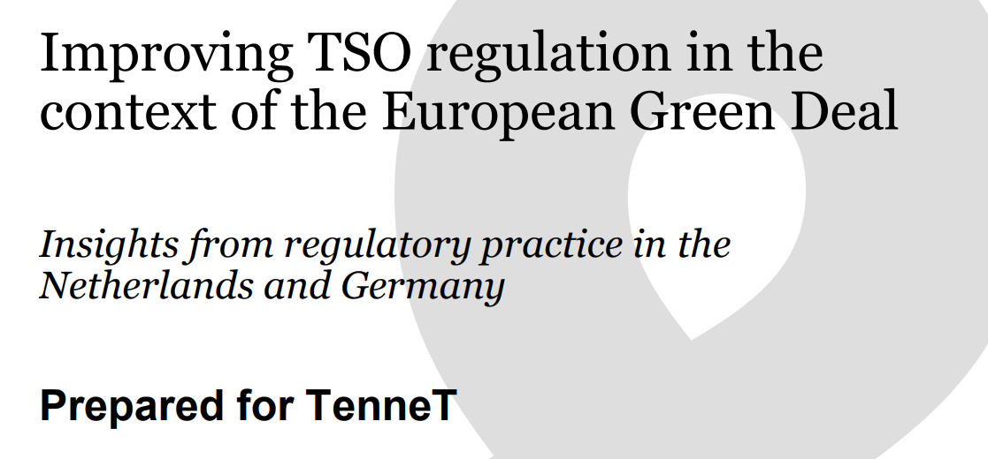
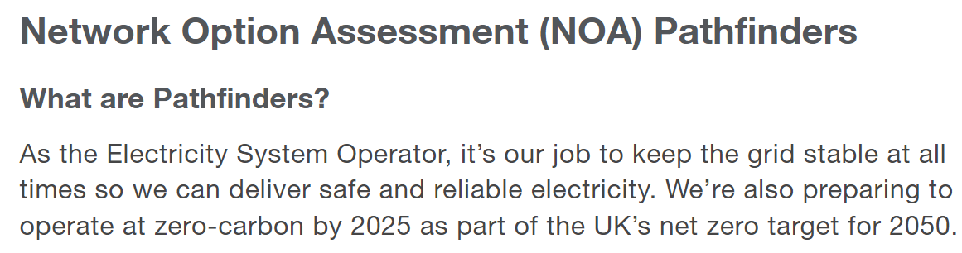
Rapid deployment of new solutions 2022-24: everything has been said

Slide 12




Follow our work:
info@currenteurope.eu
linkedin.com/current-europe/
@CurrentEurope
www.currenteurope.eu

Slide 13
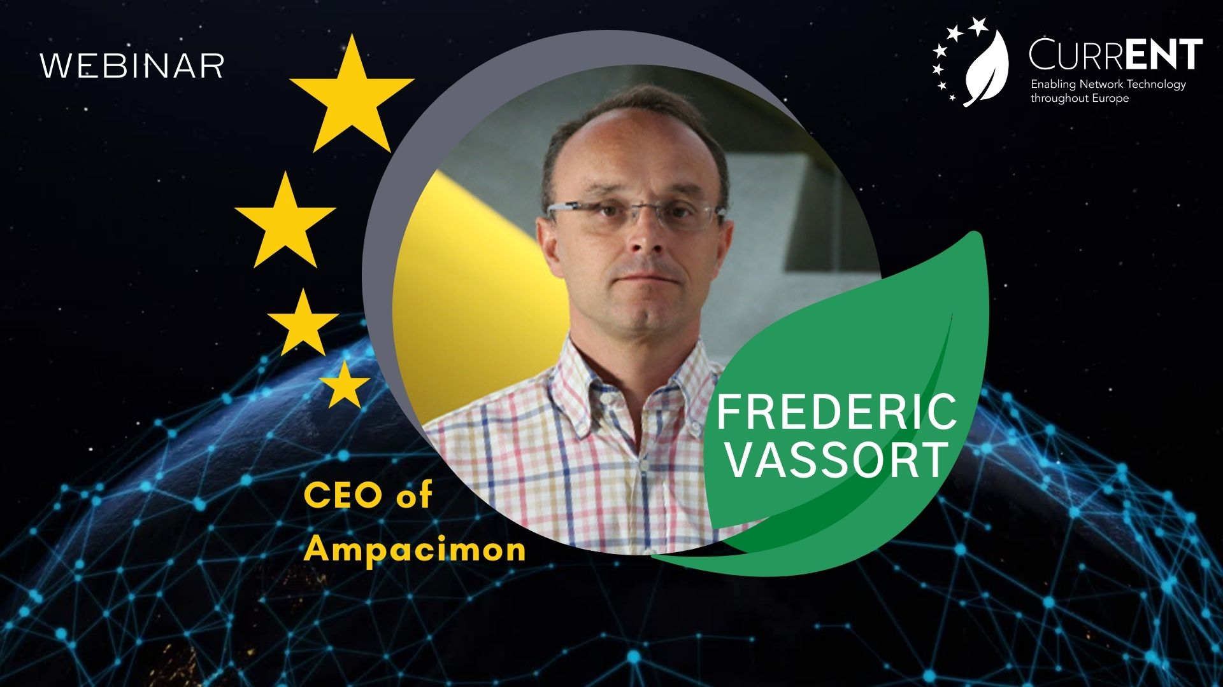

Slide 14
Dynamic Line Rating Use Cases
Nov 2019
Notes:
Thank you for having me today. I would like to present my company Ampacimon.

Slide 15

Why does grid operator use DLR?
Generally 10-20% extra capacity is available 90% of the time
In some instances twice the capacity available
Making full use of ambient cooling effect, transmission lines can be used more efficiently to transport energy
Maximum sag and conductor temperature for safety never exceeded
2×

Slide 16
What can you expect?
Example from 380kV Cross-border line in Belgium
Median value: 130-140%
90% of time 15-20% extra
KEY ASPECT FOR HIGH GAIN AND LOW RISK
Accurate LOW WIND SPEED measurement and forecast

Slide 17
Benefits of use cases
Increase cross-border exchange capacity
Reduce congestion management costs
Maximize acceptable generation infeed
Making full use of ambient cooling effect, transmission lines can be used to transport energy more efficiently
Maximum sag and conductor temperature for safety never exceeded
Short-term solution to boost transmission capacity.
Small capacity increase in high price split reap enormous returns in short time frame.
Cross border capacity benefits all citizens.
Redispatch, counter-trading, curtailment, demand response, load shedding are expensive measures.
“Cost free” measures are used first, therefore expensive measures used to address moderate (~10%) overloads.
Saved 500 kEUR in a day
①
②
10-20% increase in acceptable infeed
③
Saved 247 kEUR in 4 hours
Notes:
That’s the basic reason, to reduce the costly and cumbersome remedial actions.
But this can lead to other applications like…
Increase cross-border exchange: for example in BE it was adopted as a quick solution to impending threat of supply shortage one winter. Then they found out that in times with high price differences, a little extra capacity can reap enormous benefits in terms of saved energy supply costs.
Accelerate wind integration: like the example I showed, where there is a generally high loaded line carrying volatile infeed DLR can help. Also the main cooling effect of conductors is wind, so there is a tendency for DLR to give high gains when wind infeed is high.
Reduces the need for remedial actions and costly congestion management actions, especially if the DLR is used in day-ahead and intraday operational processes. It can counterbalance the need for redispatch and renewables curtailment that cost a lot to implement.
Improves the controllability of risks: by managing more precisely overload risks.
Defer grid investment: by providing a means to better manage the power flows in the grid, it may remove, or at least delay the need for reinforcement.

Slide 18
Benefits of use cases
Improve controllability of risk
Reduce the need for remedial actions
Accelerate renewables integration
To prevent overloading of lines (congestion), grid operators apply remedial actions in day-ahead and intraday timeframes like topology change, PST tapping, redispatch, curtailment, load shedding.
Need to use remedial actions is increasing with change in energy landscape.
Generally high loaded line carrying volatile infeed from renewables.
If forecast is wrong, it can very quickly deviate from expected loading.
This needs remedial actions (actions to avoid (N-1) security issues).
Visibility of real-time and forecast line capacity and flow allows grid operator to manage more precisely overload risks.
Data statistics-based decisions can be made to inform asset management like outage planning and maintenance intervals.
Defer grid investment
Increase in line capacity and visibility of use can be combined with power flow control.
Such grid operation-based solutions to tackle increased power flows can be counter-balanced with investment projects.
This gives flexibility in investment portfolio management.
④
No need to reschedule maintenance outage
⑤
50% increase in hosting capacity, 15% less curtailment
⑥
Alerted overload risk in recent heat waves
Up to 15% saving on CAPEX
⑦
Notes:
That’s the basic reason, to reduce the costly and cumbersome remedial actions.
But this can lead to other applications like…
Increase cross-border exchange: for example in BE it was adopted as a quick solution to impending threat of supply shortage one winter. Then they found out that in times with high price differences, a little extra capacity can reap enormous benefits in terms of saved energy supply costs.
Accelerate wind integration: like the example I showed, where there is a generally high loaded line carrying volatile infeed DLR can help. Also the main cooling effect of conductors is wind, so there is a tendency for DLR to give high gains when wind infeed is high.
Reduces the need for remedial actions and costly congestion management actions, especially if the DLR is used in day-ahead and intraday operational processes. It can counterbalance the need for redispatch and renewables curtailment that cost a lot to implement.
Improves the controllability of risks: by managing more precisely overload risks.
Defer grid investment: by providing a means to better manage the power flows in the grid, it may remove, or at least delay the need for reinforcement.

Slide 19
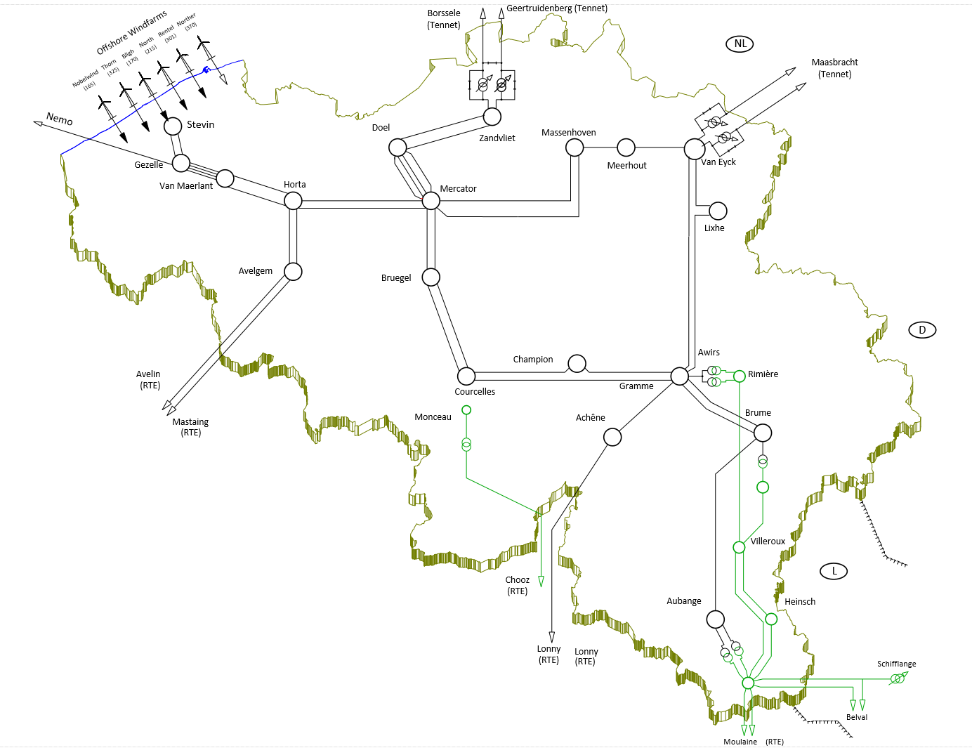

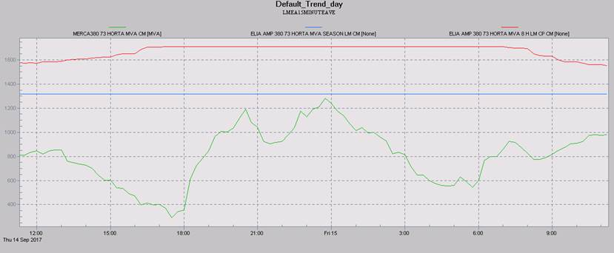
Reduce congestion management costs
1
500 000 EUR Saved in a Day
Belgium 14/09/2017 National Grid Control Center
HIGH North to South flows
OUTAGE Backbone 380kV Line
HIGH wind infeed expected
OVERLOAD threatening grid security!
Congestion management actions in Belgium
Grid
Switch configuration
Transformer setting
Consumption
Industrial consumption schedule
Distributed demand response (e.g. battery)
Load shedding
Full! No options left!
Production
Thermal power plant schedule
Renewables curtailment
Countertrading
Market
Rating capped (TSO rules)
Dynamic Line Rating on critical 380kV Lines
+30% extra capacity released
Capacity steep increase - due to wind
Outage: load shift starts
Redispatching avoided
Prepare for intl. RD!
AVOID further PST tapping
AVOID 500 000 EUR of International Redispatch
*International redispatch cost +500EUR/MWh (Elia)
https://www.entsoe.eu/events/2019/03/20/smart-grid-world-of-innovations-dynamic-line-rating-webinar/
Notes:
Now I will describe an example of how DLR is actually used:
THIS IS TYPICALLY HOW YOU WOULD SEE THE OUTPUT IN CONTROL ROOM
Typically, in the grid operation center, the grid is prepared to be in operation based on expected levels of consumption and power generation.
This means, the power lines and substation equipment in service, not out of service for maintenance, transformers at specific tap settings, switches and breakers either closed or opened, etc.
In a day-ahead timeframe, grid operation is prepared based on expected power flows resulting from the forecasted consumption for tomorrow, and the power plant generation schedules. In the case of Europe, where power sector is fully unbundled, this means the dispatch result after day-ahead market trading is closed.
The example shown here, describes what happened after market close on 13th September 2017.
On the 13th of September, the grid operation center was facing a challenging outlook for the next day.
Energy exchange between Germany and France (which inevitably flows through BE) was settled on the day-ahead market, meaning they were expecting high North to South flows on the backbone transmission network, especially in the evening peak hours, when demand picks up, and when Germany had plenty of wind energy to export. However, one of the backbone transmission lines was out of service due to maintenance works (it was being upgraded to a line with higher capacity, to an HTLS line, so it could not be brought back into service at short notice).
At this stage, this meant that during those peak hours, it was highly likely that the resulting power flows would be too high to ensure an N-1 security of the grid. Therefore the operators in the grid control center prepared to change the transformer tapping at the Phase Shifting Transformers positioned at the borders of BE with NL, to redirect the power flow away from the congested areas. The maximum tap setting for the PST is 18, but for day-ahead operation typically it is limited to maximum of 6 (to leave room for emergency situations in intraday). So the PST tapping was prepared to be at maximum possible setting for day-ahead.
However they realized that this would not be enough to get rid of the potential N-1 security violation. Therefore they decided to make some topological arrangements in the 150kV sub-transmission grid, also to redirect away some power flows.
Even with all the effort by the grid operator to solve the congestion using his own assets, it would still not get rid of the potential N-1 security threat.
So, at this point they prepared to instruct some power plants to redispatch – this means, instructing power plants in France to divert from their production schedule and increase their output, while at the same time instructing power plants in the Netherlands to decrease their output. – Belgium is limited in terms of power plants in its own territory, especially to counter the expected large North to South power flow.
Then the clock ticked over into the next day, 14th of September!
As the intraday activities started on the 14th of September, updates to the forecast consumption, to the power plant production schedules considering also intraday-trading results started to roll in. Elia swiftly updated the expected power flow calculations for the critical evening peak (in reality, this is done not only for the evening but on a rolling basis for every hour of the day). The result was still quite tight, but manageable. The topological measures set in place the day before stayed as it was. The Phase Shifting Transformers however did not have to be tapped as high as anticipated. The taps were set to 4 instead of 6.
The resulting power flow is shown in the figure as the green curve. This is the actual line loading on the 380kV transmission line. The blue line is the Static Seasonal Rating, while the Red curve is the DLR coming from the Ampacimon sensors.
It can be seen that in the critical evening peak hours, the line loading became very close to the SLR. If the N-1 security calculations had been based on the SLR, this flow for sure would have results in a security violation, causing the need to tap the PSTs to 6 or even higher, and definitely to activate the redispatch instruction of the foreign power plants.
However, since Elia knew with sufficient confidence that in fact in reality there would be sufficient line capacity given by reliable DLR, the grid would be N-1 safe, without any action. This is because Elia is confident in the fact that DLR is a reliable limit to replace the SLR in N-1 security calculations.
Therefore, for this particular case described for 14th September, DLR was able to save Elia expensive redispatching actions, and also the need to tap further the PSTs.

Slide 20
Thank you !
Frederic Vassort

Slide 21


Slide 22
CurrENT Webinar – NOVA
Use Case - Reinforcement
13th December, 2022
Notes:
Data is pulled from installation records, Incident ID reports, FAST reports, and previous incident history reports.

Slide 23

NOVA “V “ (Verstärkung) – How Is This Typically Delivered?
REINFORCEMENT
EXISTING LINE ROUTES.
NEW LINES
Conductor Selection: HTLS
Source: Bundesnetzagentur & Agora Bericht
„Toolbox für die Stromnetze“.
= High Temperature Low Sag

Slide 24
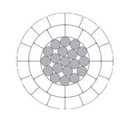
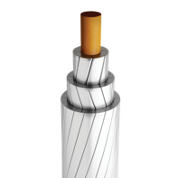

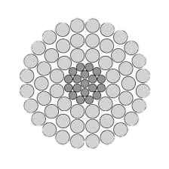
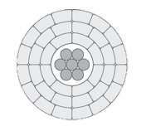
Conductor Evolution
Traditional Conductors
Timeline
1920s
1970s
1980s
2000s
Demand Increase
Challenges
  Higher Temperature Leading To
  Aluminium Stability Issues
  Increased Sag
  Increased Line Losses
ACSS
Advanced steel core.
E.g. TACIN/INVAR, Gap
POLYMER OR
Metal-matrix CORE
ACsR
HTLS
(High Temperature Low Sag)
HCLS
High Capacity Low Sag

Slide 25
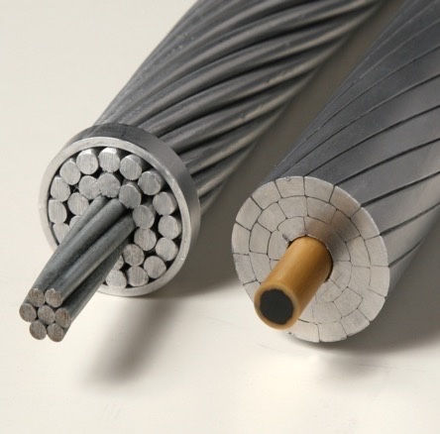
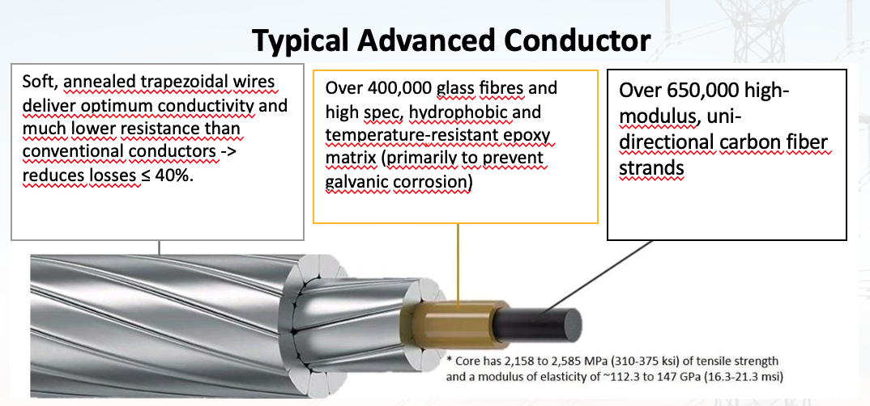
How Advanced Conductors Work.
HCLS
High Capacity
Low Sag
ACCC®
Aluminum Conductor Composite Core
Conventional Steel Core
Advanced MMC or PMC Core

Slide 26
©️ CTC Global 2022
Use Case -
Elia MMVE (Massenhoven-Meerhout-Van Eyck) 380kV
Replacing existing AAAC with Advanced Conductors
2nd Circuit with Advanced Conductors
Total Circuit Length: 92km
Project Years: 2021-2 (one circuit/year)
Further Information can be found HERE

Slide 27
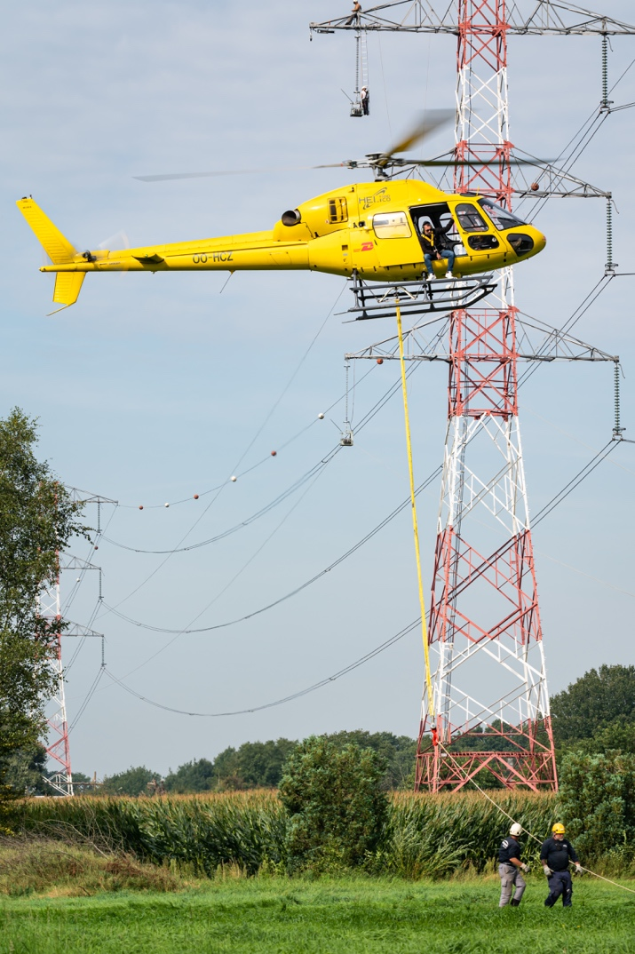
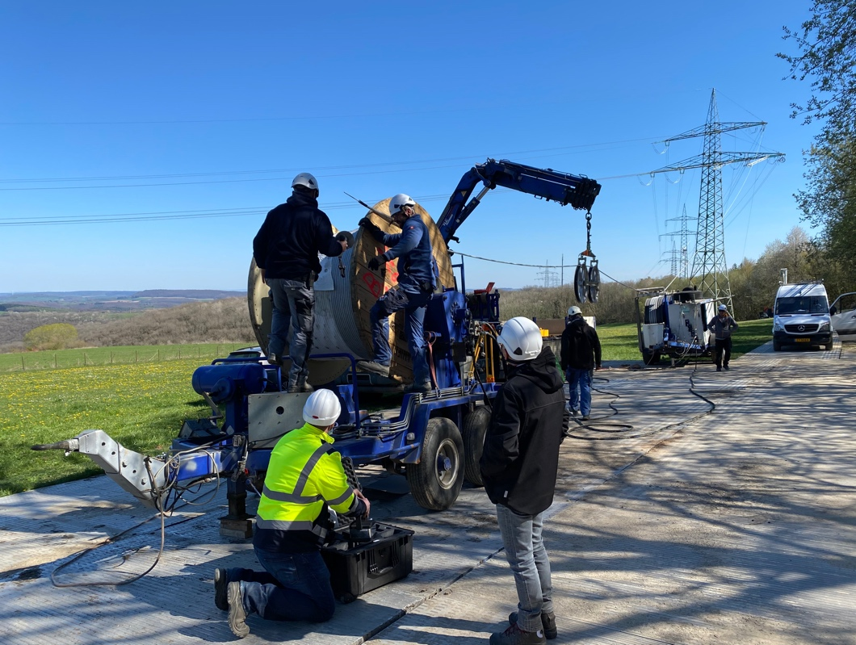
©️ CTC Global 2022
Use Case -
Elia MMVE Reference Photos
Composite Core Integrity Inspection System
Source: Elia/CTC
Installing Pilot-line
Source: Elia/Kris Kristians

Slide 28
Use Case –
Elia’s Justification For Advanced Conductors on MMVE
Why Did Elia Choose Advanced Conductors For the MMVE route?:
High Capacity: Circuit capacity increase from 1,100 to Ca. 2,000A
Low Sag: Advanced Conductors guarantee stable sag profile
Efficiency Gains: 25-40% + compared to traditional ACSR. Saves € millions annually in wasted generation
Future-Proofing: Permit Future RES Connections (Energy Transition)
Lowest Project Costs: leverage existing infrastructure with few modifications
Conclusion:
Advanced Conductors maximise efficiency and future-proof network at lowest project costs.

Slide 29

The Home of ACCC® - World‘s Leading Supplier of Advanced Conductors
https://www.ctcglobal.com
Presenting:
POC | Email | Mobile
Peter Hughes | phughes@ctcglobal.com | +49 151 142 36424
Notes:
Damit ist unsere Zusammenfassung abgeschlossen, und wir würden uns freuen, wenn wir Ihnen an dieser Stelle weitere Fragen zu CTC, unseren Fähigkeiten und den neuen Entwicklungen, die wir heute vorgestellt haben, beantworten können.

Slide 30
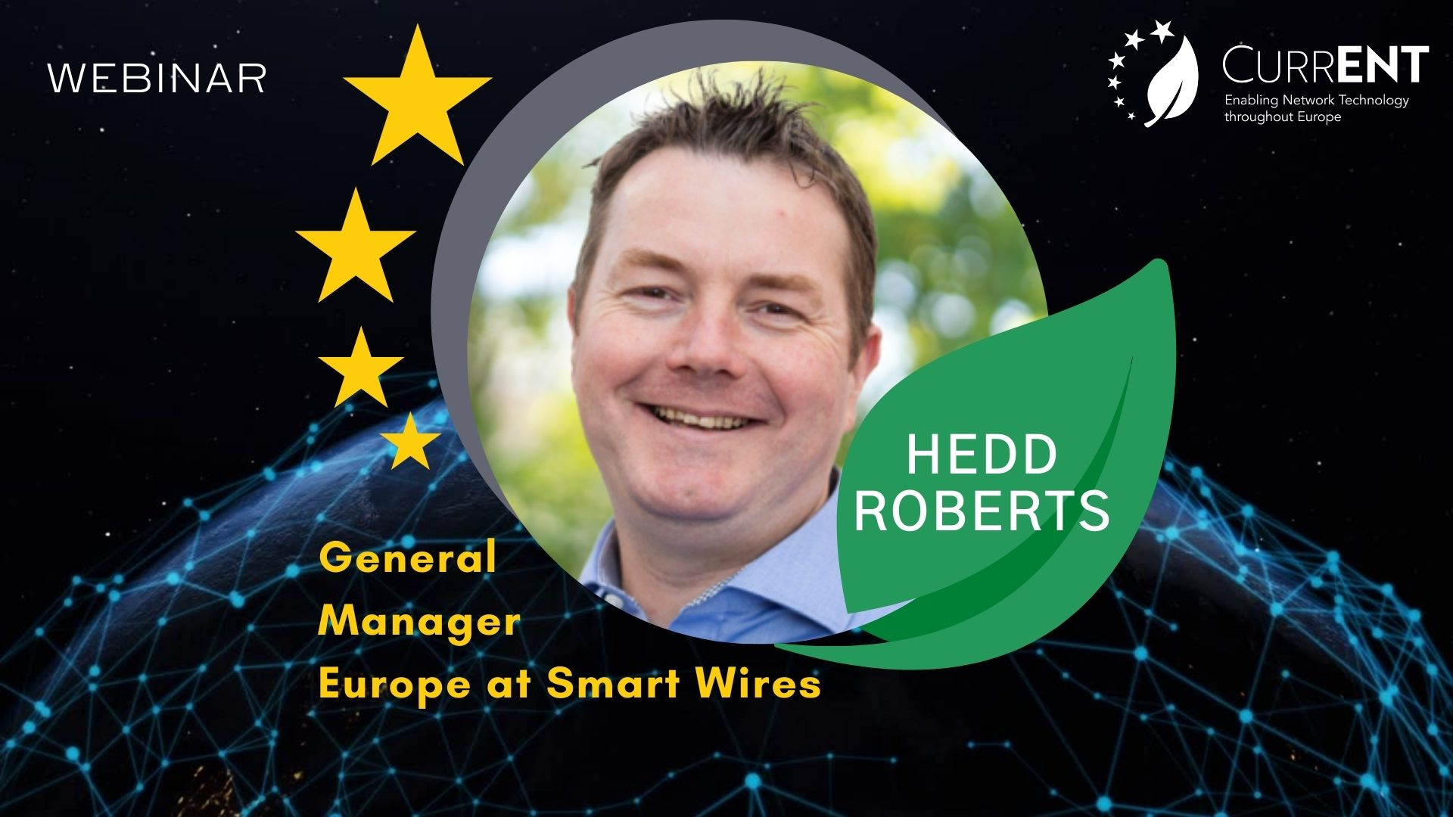

Slide 31
currENT webinar
Smart Wires case study: National Grid
13/12/2022

Slide 32




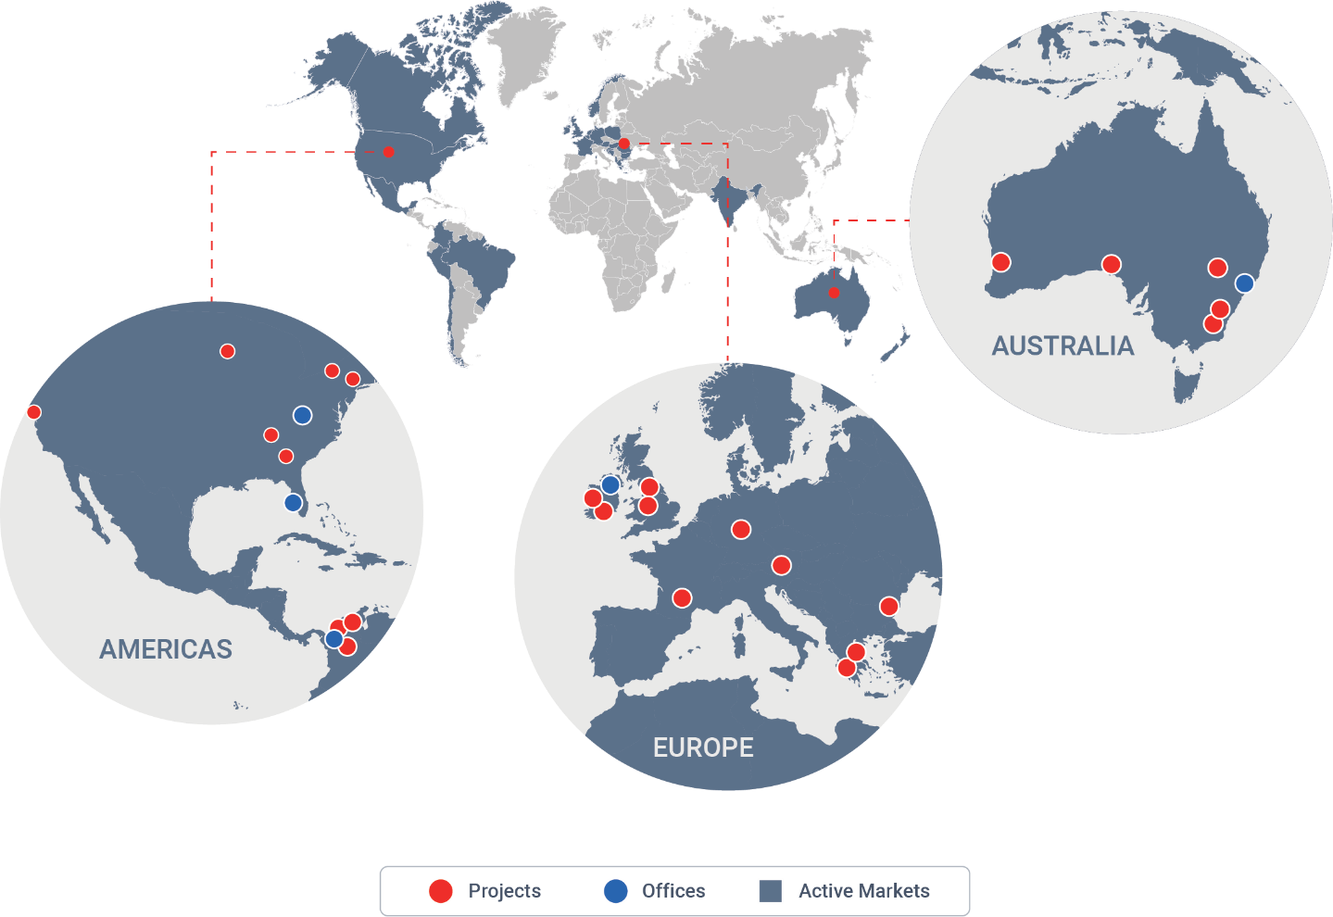


Introduction to Smart Wires
Leadership: GE Renewables, PG&E, Wright Medical, EirGrid, ENTSO-E
Strong Team: Over 300 industry-leading experts
Global Culture: More than 30 nationalities represented
Diverse: Strong diversity throughout the organization
Tech Hub & HQ: North Carolina, USA
ISO 9001 Manufacturing: St. Petersburg, Florida, USA
Global Presence: Additional offices in Ireland, Colombia, Australia and a global workforce
Intellectual Property: patents, know-how and technology stack
Operational Record: 2,900+ device-years of operation
Major Partners: Mitsubishi, Infineon, Jabil, Powersoft 19
Notes:
Last modified: May 2021

Slide 33
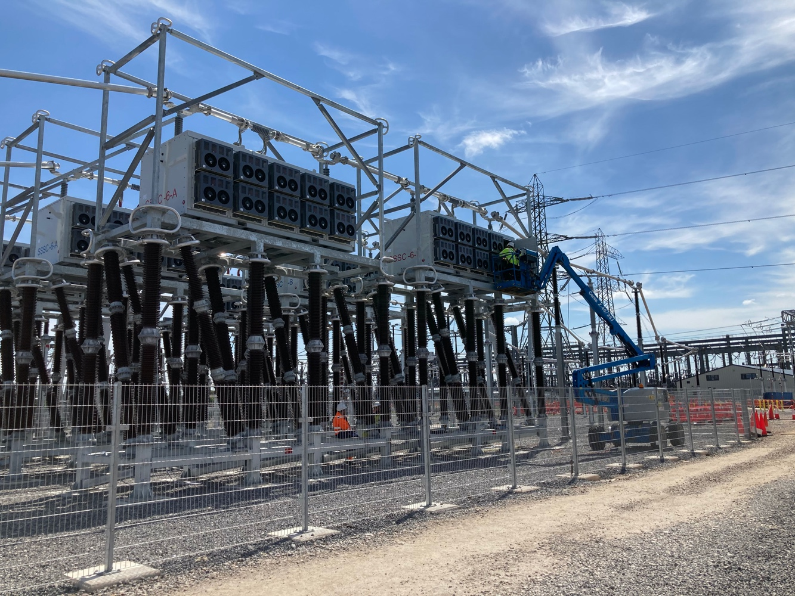
Case Study: What is the GB Context?
How are proposals to increase transmission boundary capacity treated in GB?
Independent System Operator runs annual Network Options Assessment (NOA) to assess Transmission Owner proposals to increase capacity across main transmission system boundaries
  Uncertainty of future need is somewhat represented with proposals tested against multiple future energy scenarios
  Proposals which minimize regret (when investment financing and congestion costs are considered) are given signal to proceed
Transmission Owner Price Control includes ex ante unit cost allowances for increased boundary capacity
  Unit cost allowances are set at the start of each Price Control period (now 5 years) based on available technology
  If Transmission Owner can achieve increased boundary capacity at a cost lower than the allowance, then saving is shared between Transmission Owner and consumers

Slide 34
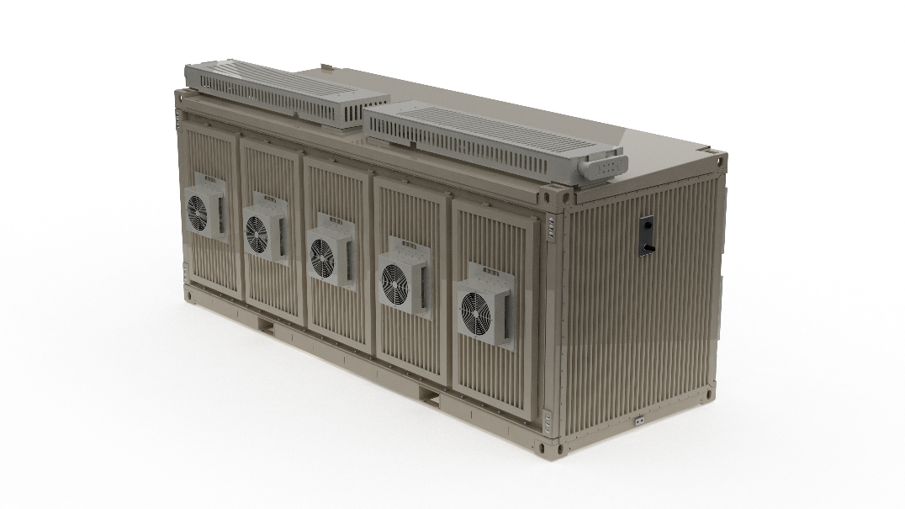

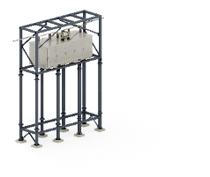
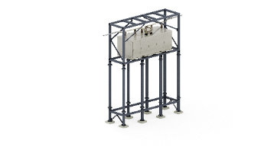
SmartValveTM - Key attributes of modular power flow control
The SmartValve: is a modular Static Synchronous Series Compensator (M-SSSC)
Power Electronics Technology: that injects a controllable voltage (leading or lagging) in to a circuit, either manually or automated controls.
Main Application: dynamic power flow control
Flexible Electrical Deployment: Same unit can be used at any voltage in network; scaled or rescaled to meet the need
Flexible Physical Deployment: Substations, in the existing right-of-way, or on mobile platforms, light and compact
Wider Use Cases: solve small near-term and large long-term problems at any voltage level
Fast deployment: 1 Year deployment possible from order to installation
High Security: Combined capability offers naturally high reliability and redundancy
Lifetime: 40 year plus
Notes:
Last modified: May 2021

Slide 35
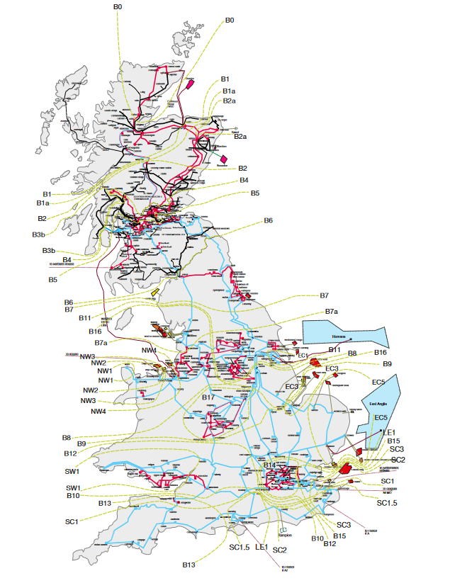
Case Study: What was the problem?
Where was the lack of transmission capacity, and what was causing it?
Connection of new renewable generation in Scotland is increasing power flow from Scotland to England
This powerflow is restricted by a number of transmission system boundaries between Scotland and England and in Northern England
Major reinforcements planned, such as offshore HVDC links, but they take time
Boundary capacities significantly lower than sum of thermal capacities of transmission lines due to circuit sharing
SmartValve can be used to improve circuit sharing and therefore improve boundary capacity
B6
B7
B7a

Slide 36

Case Study: What was the solution?
How were SmartValves deployed to address the boundary capacity restrictions?
Stage 1
48 SmartValves were deployed to three substations in Northern England (Harker, Penwortham and Saltholme), and connected into five circuits
This increased the boundary capabilities as follows:
  B6: +500MW
  B7: +900MW
  B7a: +500MW
This was cost effective [£387m saved for GB consumers], quick [deployed within 12 months] and flexible [expandable and redeployable]
Stage 1 extensions
Building on the success of the stage 1 installations, National Grid Electricity Transmission extended the capability of the SmartValve deployments at Harker and Penwortham substations with an additional 18 SmartValves
This further increased the boundary capabilities as follows:
  B6: +400MW
  B7: +500MW
  B7a: +200MW
B6
B7
B7a

Slide 37
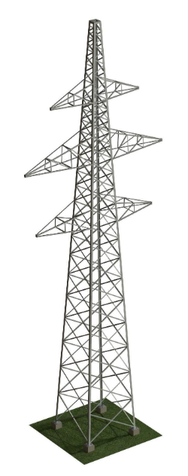

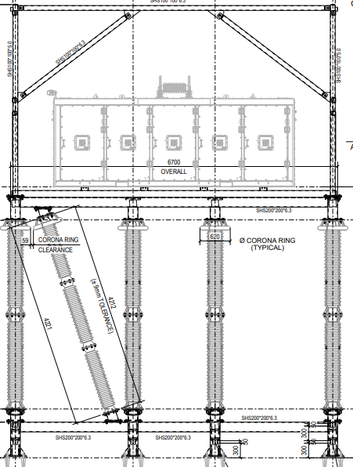
Stage 1 at Harker 275KV substation
Total Devices:
21 x 9-3200
Harker – Fourstones (7.8Ω)
Legend
9-3200
10-1800
Harker – Stella West (3.5Ω)

Slide 38
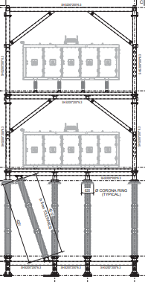
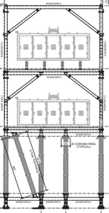

Stage 2 accommodated without increasing installation footprint
Total Devices:
21 x 9-3200 (+9)
21 x10-1800 (+12)
Devices moved from Harker – Stella West
Harker – Fourstones (20 Ω)
Legend
9-3200
10-1800
Harker – Stella West (14 Ω)

Slide 39
Hedd Roberts
General Manager Europe
Hedd.Roberts@smartwires.com
+44 7446 829181
Glencullen House, Kylemore Road, Dublin 10, D10 CA33, Ireland

Slide 40


Slide 41
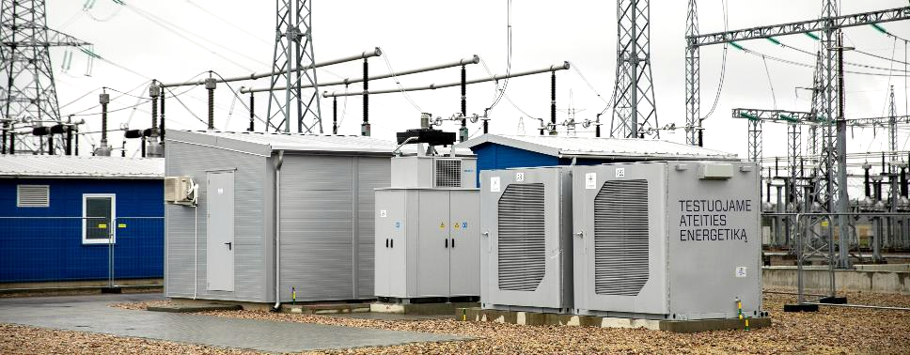
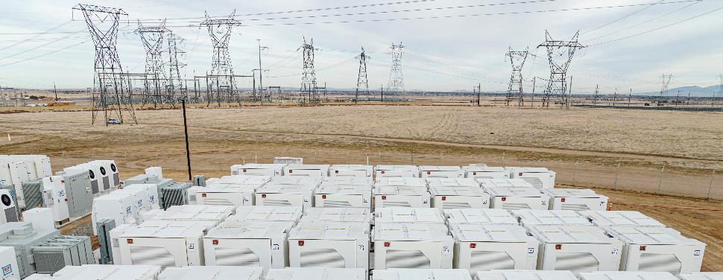
Enabling the Grid 2.0 through next generation energy storage
Two primary value drivers across seven Fluence solutions for TSO customers
Transmission Network Utilization Enhancement
CONTINGENCY SUPPORT
CONGESTION MANAGEMENT
EMERGENCY POWER CONTRIBUTION
Dynamic Voltage Control
Advanced System Operation Stabilization
SYNTHETIC INERTIA AND VIRTUAL SYNCHRONOUS MACHINE
OSCILLATION DAMPING CONTROL
SYSTEM RESTORATION (BLACK START)
SYSTEM STRENGTH (DYNAMIC VOLTAGE CONTROL & SHORT CIRCUIT CURRENT)
© Fluence Energy, Inc. All rights reserved. |
Notes:
Key talking point:
To enable smart transmission from the Grid of the future or Grid 2.0, storage can provide two important streams of value directly to transmission owners and operators
Transmission network utilization – maximize utilization of conventional infrastructure to ensure high efficient, cost effective system
System operations – enable a high renewables penetration future and a high converter based future that does not rely on rotating machines for their inherent value

Slide 42

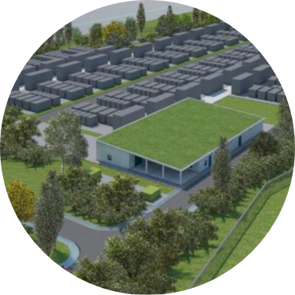



Gridbooster (Netzbooster) Projects
– Easing Congestion in the German Transmission System
Fluence is a first mover in the German TSO segment with success at Transnet
Projects launched as part of Gridbooster program
GERMANY
Size : 1 x 250 MW / 1Hr COD : Q2 2025 Project status: Awarded to Fluence
Size : 2 x 100 MW / 1Hr
COD : Q3 2025
Project status:
Govt. Approval in process
TENNET Grid Service Corridor
Benefits : Reduce need for conventional reinforcement, operating costs & avoid derating of lines. Ease bottlenecks stemming from moving wind energy from northern Germany to southern load centers. Overall, reduces re-dispatch costs and lowers end user energy costs
TRANSNET Grid Service Corridor
International experience : Projects similar to the German gridbooster are ongoing in Australia (700 MW Waratah battery) and Chile (2x500 MW), and considered in many other countries (US, India)
ESS
© Fluence Energy,. Inc All rights reserved. |
42
Notes:
Germany currently has 2 big Gridbooster tenders ongoing
Both Gridboosters are looking to optimize the grid and come under Germany’s NOVA prinzip. Which is basically optimization before grid expansion.
The batteries, in addition to mimicking a transmission line is able to provide additional service like stability services, integration into protection schemes, and so on.
The transnet project has been awarded to Fluence with COD in 2025 and we are looking at a customer decision in the next weeks on Tennet
Purpose of the Grid Boosters is to increase transport capacity of the existing grid without adding additional lines. The batteries take over the N-1 for the transmission grid.
In case of TenneT it is primarily about transportation of energy and power from the north (wind generation) to the south (industrial demand). The system in the north is primarily empty. The Grid Booster in the South is full. In case one of the lines trips (without N-1) that BESS jumps in. Means the BESS in the north is charging and the BESS is the south is discharging. In turn, the transport capacity is not reduced despite the failure of one line
Sales cycle (for Transnet) : pre RFP engagement ( Q2 2020)→RFP ( Feb 2022)→ Order (Sep 2022) = 24 months
Only competitor was NIDEC- VARTA-BKW Swizz consortium and offered a solution,,, eventually Fluence became lead due to Siemens+Fluence relationship….
Based on 2020 Pre RFP engagement Transnet had put a cap on CAPEX, however as cost escalated, Transnet had to rework the CAPEX and secured permission from authorities to raise the CAPEX $ limit
What is re-dispatch cost?
https://www.cleanenergywire.org/factsheets/re-dispatch-costs-german-power-grid
On particularly windy days when demand in the north is low, this means renewable electricity fed into the grid exceeds the capacity of the power lines that are supposed to transport electricity to the south of the country. A kind of congestion occurs, forcing grid operators to take re-dispatch measures in order to stabilise the network.
grid operators can resort to three different types of re-dispatch measure:
They can order conventional power stations in north Germany to reduce generation, in order to “make space” in the grid for the high influx of wind power
They can temporarily shut down wind turbines (only as a last resort, because renewables have grid priority)
They can order conventional power stations in south Germany to produce more electricity to meet demand from consumers in the south whose suppliers bought north German wind power that can’t get through.

Slide 43
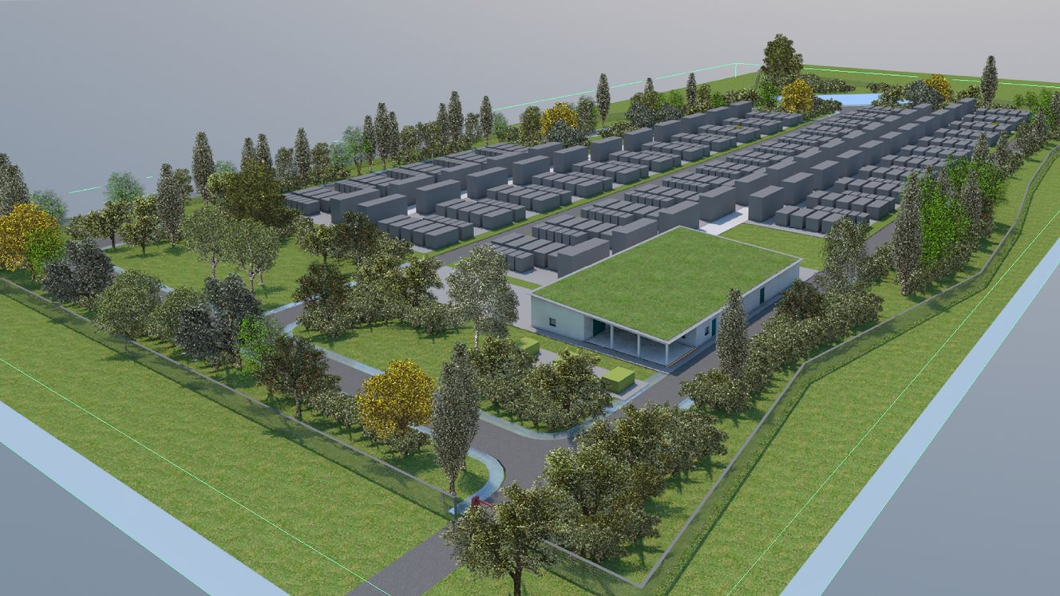
CASE STUDY
Grid utilization enhancement
TransnetBW (Germany)
250 MW / 250 MWh
Applications
SpPS integration (EPC signals)
Active & Reactive Power Control
Inertia
Islanding & black start (restoration services)
Dynamic Voltage control
Power Oscillation Damping (Patent filing in progress)
IMPACTS
Ease bottlenecks transporting wind energy from northern Germany & avoids derating of lines
Reduces redispatch cost & lowers end user energy cost
Stability & grid reinforcement services
© Fluence Energy, Inc. All rights reserved. |
Notes:
Diving a bit deeper into Transnet.
The transnet project located in the city Kupferzell in the South of Germany. From an outside perspective it is a 250MW - 1h system.
But in reality the system is 354MVA 400MWh because of complying to the complete active and reactive power requirements. And the complete QU profile that needed to be fulfilled
This system is able to cater to a host of applications listed here such as
But the overall impact is that the costs for end users are going down and the TSO has a very powerful system giving them flexibility for grid operation.

Slide 44
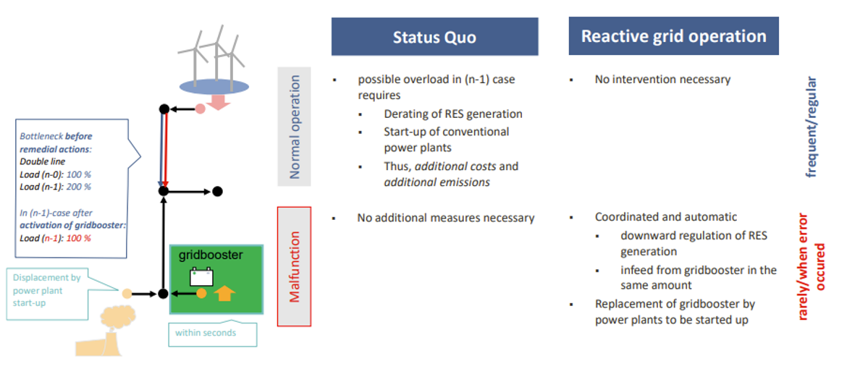
Gridbooster concept of reactive/curative grid operation
© Fluence Energy, Inc. All rights reserved. |

Slide 45


Slide 46
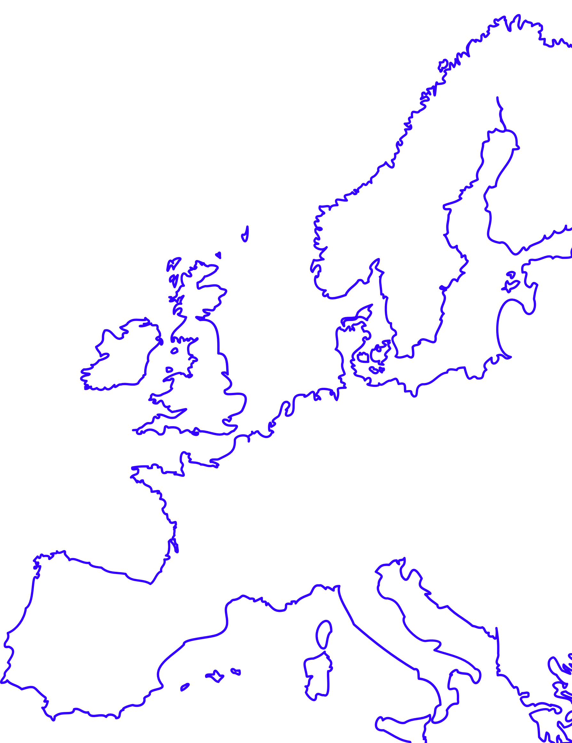
13 December 2022
The TYNDP is the European electricity infrastructure development plan.
It provides a pan-European vision of the future power system and investigates how power links and storage can be used to make the energy transition happen in a cost-effective and secure way.

Slide 47
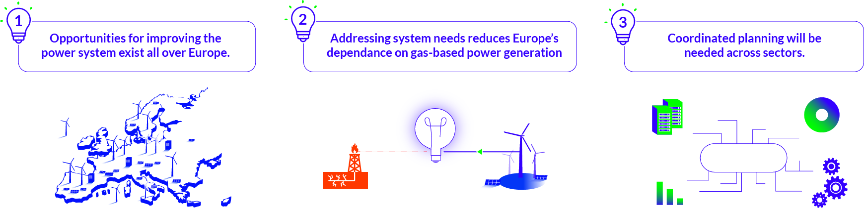
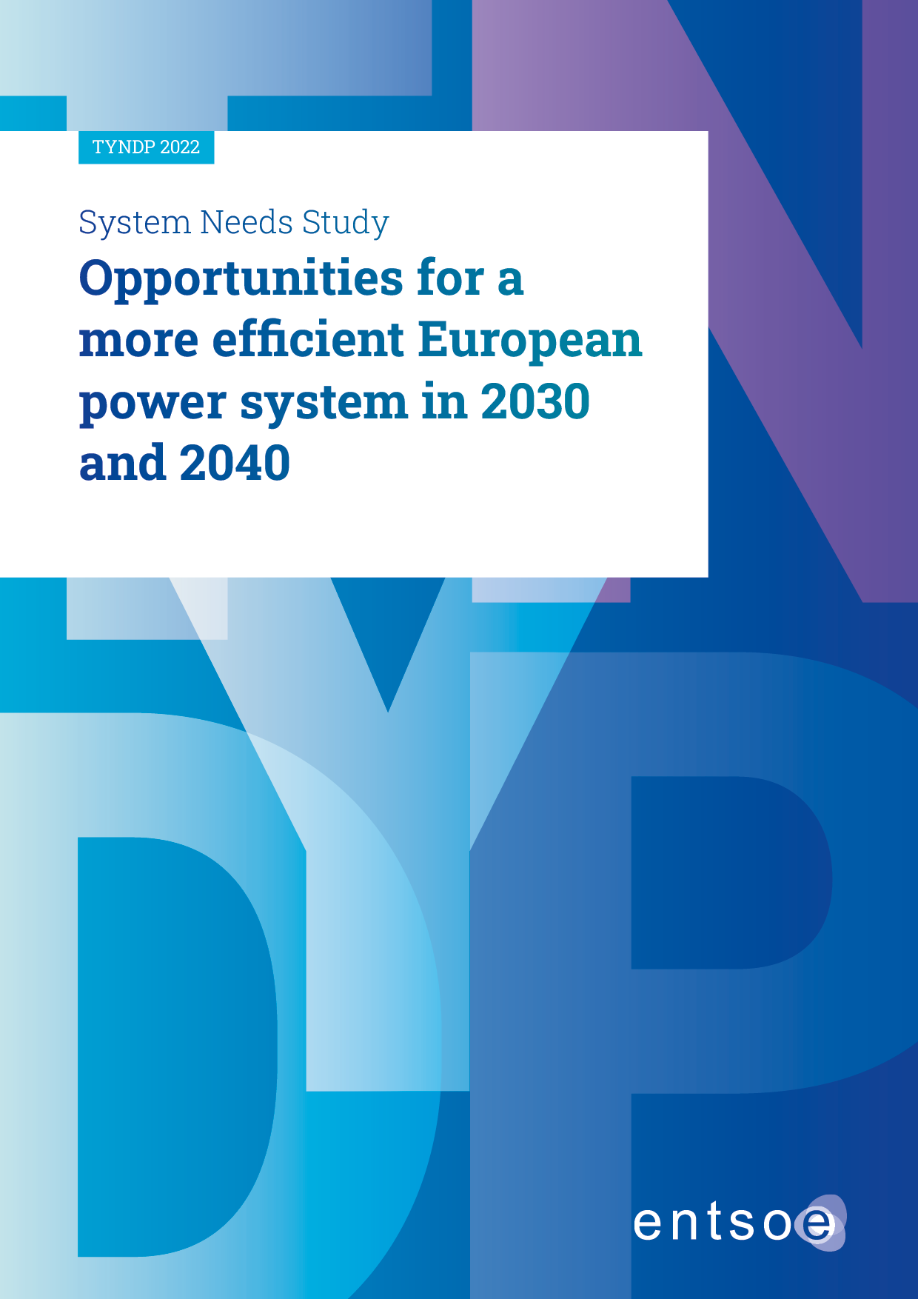
TYNDP 2022 system needs study
Three key findings

Slide 48
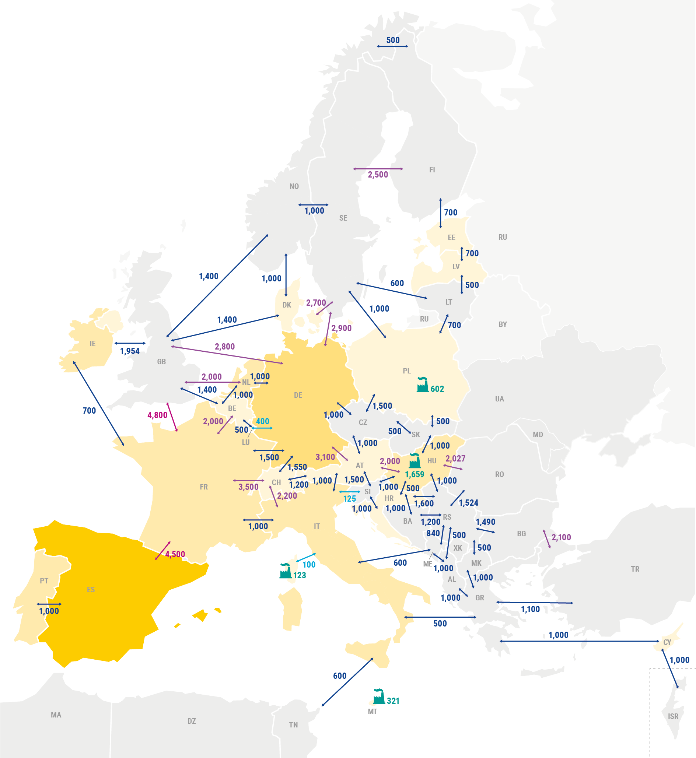
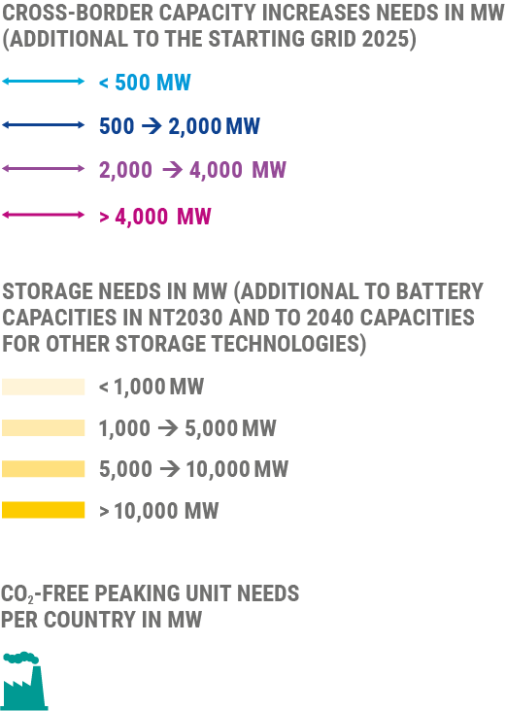
Results
Opportunities for increased cross-border transmission, storage and peaking capacity exist all over Europe
Opportunities for increases in cross-border transmission, storage and peaking units capacity in 2040

Slide 49










How to understand the results
One economic needs configuration, multiple solutions
Non-infrastructure solutions
Addressing tomorrow’s challenges will require the parallel development of a diverse range of solutions, including for example storage, the role of prosumers and generation, in addition to reinforcing the transmission grid.
Demand side
response
Regulation
Smart Grids
Storage
Smart Sector
Integration
Market design
Operational
measures
Electricity infrastructure solutions
Our study uses interconnection transmission capacity and storage and peaking flexibility to express the needs because it is based on electricity TSOs’ expertise, data and models, but solutions extend beyond electricity infrastructure.
Transmission lines
Energy Storage
Peak units
Hybrid solutions

Slide 50

How to understand the results
One economic needs configuration, a multiplicity of solutions

Slide 51



Solutions
Innovation Uptake: at the centre of ENTSOE´s mission
Innovation Uptake through Regulation
ENTSO-E Technopedia (solutions)

Slide 52


Slide 53


